Slide 1

Key Points from the Video
Inventory includes items held for sale (including raw materials and work-in-process)
Be aware of goods in transit (depends on terms) and on consignment
Inventory costs include all to prepare the goods for sale (not just unit costs)
NOTE: Exam 1 Answers Open

Slide 2

Challenges with valuing inventory
What goods are included in inventory?
Which costs are included?
Which items (costs) did we sell?
What if the value changes?
Notes:
Is a plant manager’s salary part of inventory? What about an accountant’s salary? What do I do with transportation costs?
What’s the value of a phone after a new version is released?

Slide 3

Inventory Part 1 – In-Class

Slide 4
Two decisions companies make
When to record COGS/Inventory shipment
Periodic
Perpetual
Cost flow assumption
FIFO
LIFO
Avg. Cost
Specific

Slide 5
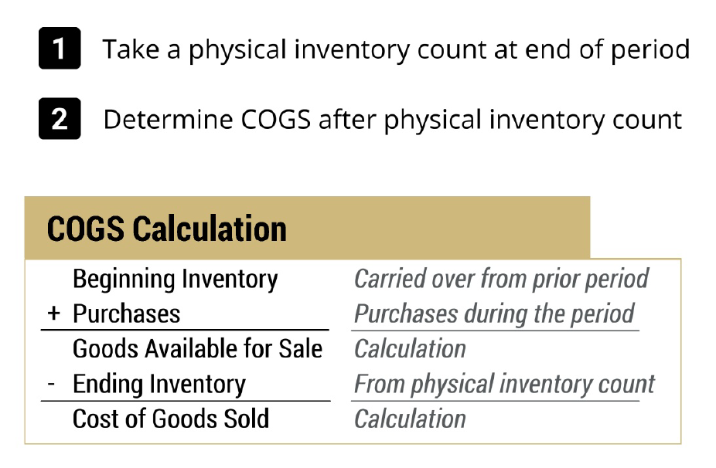
Periodic System

Slide 6
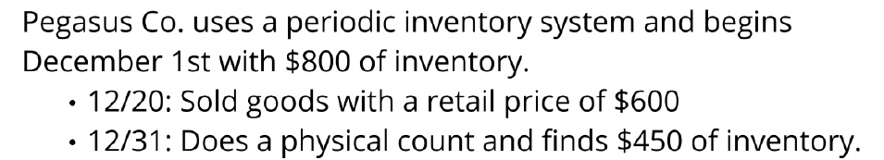
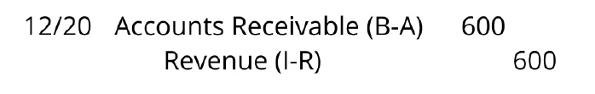
Periodic System

Slide 7
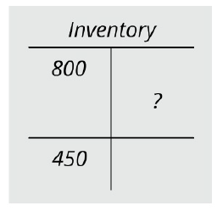

Periodic System

Slide 8
Periodic System

Slide 9
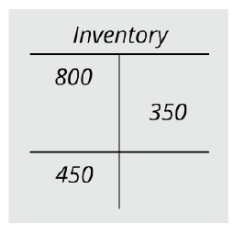
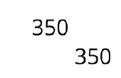
Periodic System

Slide 10
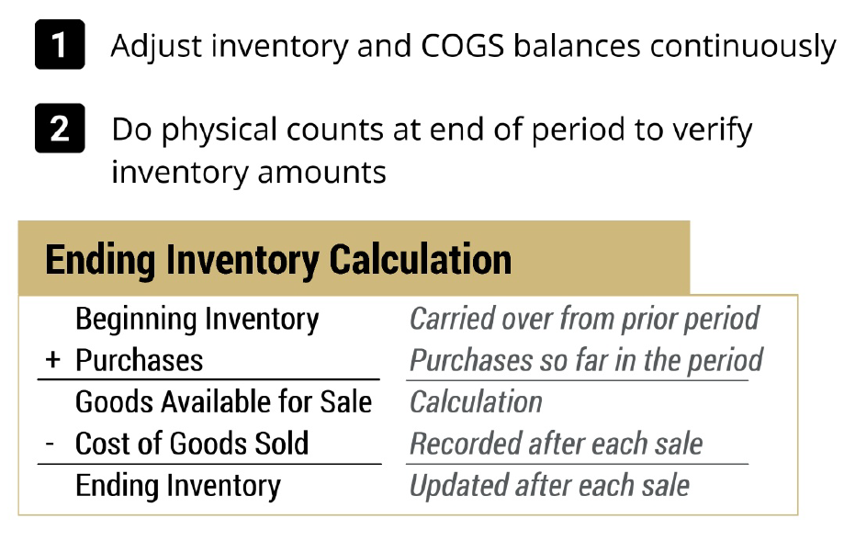
Perpetual System
10
Notes:
1) All products must end the period in one of these two buckets
-sold in COGS
-unsold in Inventory
2) Parallels last class:
Allowance (estimate end balance and plug expense)
Bad debt (calculate expense and plug end balance)
3)
Periodic:
-pretty accurate for most firms external reporting
-assume this method in this class going forward
Perpetual:
-more likely for internal information

Slide 11
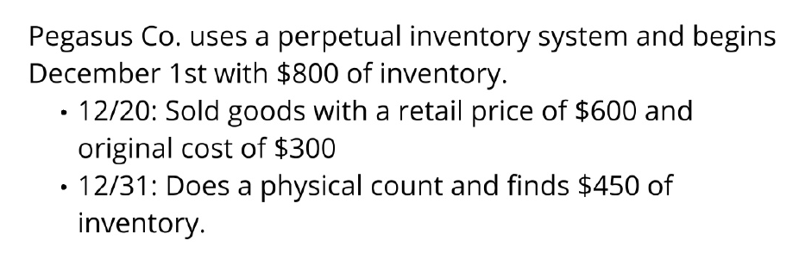
Perpetual System

Slide 12

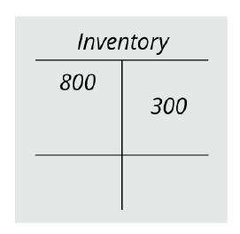
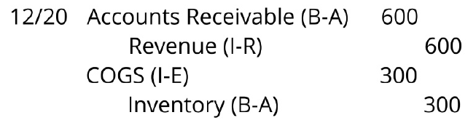
Perpetual System
500

Slide 13
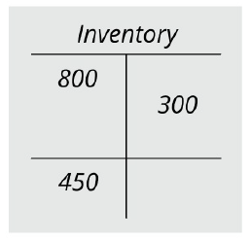
Perpetual System
500

Slide 14
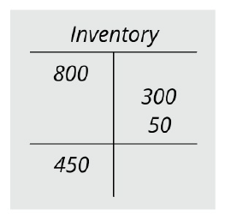
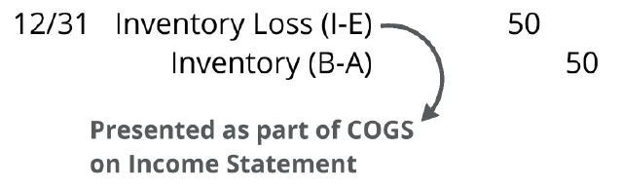
Perpetual System
500

Slide 15
Two decisions companies make
When to record COGS/Inventory shipment
Periodic
Perpetual
Cost flow assumption
FIFO
LIFO
Avg. Cost
Specific ID

Slide 16
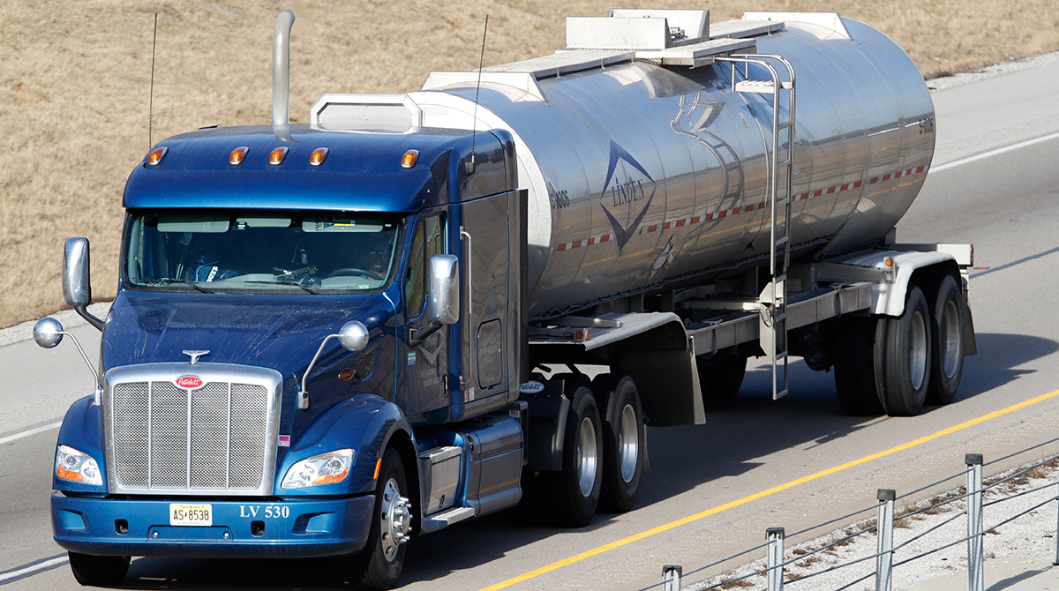
Inventory: The need to make cost-flow assumptions
New gas station begins operations
Day 1: Buy 500 gallons of gas @$1/gallon
Day 2: Buy 300 gallons of gas @$1.50/gallon
300 gallons @ $1.5/g = $450
What cost should we use for each gallon?
OR
800 gallons @ $1.19/g = $950
500 gallons @ $1/g = $500
Notes:
Once we figure out the # units sold vs. retained, still have one issue – Cost allocation.
Know Rev=$2 x 200 gal
Know sold 200 units: which units were sold?
-have 800 units to sell, which do we assume are sold?
What is COGS? (price per gallon)
-is it $1 or $1.50 or some average cost between these?

Slide 17
Inventory: The need to make cost-flow assumptions
New gas station begins operations
Day 1: Buy 500 gallons of gas @$1/gallon
Day 2: Buy 300 gallons of gas @$1.50/gallon
Day 3: Sell 200 gallons of gas @$2/gallon
200 gallons @ $1.5/g = $300
Last In-First Out (LIFO)
300 gallons @ $1.5/g = $450
OR
Sell
800 gallons @ $1.19/g = $950
200 gallons @ $1/g = $200
First In-First Out (FIFO)
500 gallons @ $1/g = $500
200 gallons @ $1.19/g = $238
Average Cost
Notes:
Once we figure out the # units sold vs. retained, still have one issue – Cost allocation.
Know Rev=$2 x 200 gal
Know sold 200 units: which units were sold?
-have 800 units to sell, which do we assume are sold?
What is COGS? (price per gallon)
-is it $1 or $1.50 or some average cost between these?

Slide 18
Inventory: The need to make cost-flow assumptions
New gas station begins operations
Day 1: Buy 500 gallons of gas @$1/gallon
Day 2: Buy 300 gallons of gas @$1.50/gallon
Day 3: Sell 200 gallons of gas @$2/gallon
300 gallons @ $1.5/g = $450
Last In-First Out (LIFO)
Ending Inventory
100 gallons @ $1.5/g = $150
Sell
200 gallons @ $1.5/g = $300
500 gallons @ $1/g = $500
500 gallons @ $1/g = $500
Notes:
Once we figure out the # units sold vs. retained, still have one issue – Cost allocation.
Know Rev=$2 x 200 gal
Know sold 200 units: which units were sold?
-have 800 units to sell, which do we assume are sold?
What is COGS? (price per gallon)
-is it $1 or $1.50 or some average cost between these?

Slide 19
Inventory: The need to make cost-flow assumptions
New gas station begins operations
Day 1: Buy 500 gallons of gas @$1/gallon
Day 2: Buy 300 gallons of gas @$1.50/gallon
Day 3: Sell 200 gallons of gas @$2/gallon
300 gallons @ $1.5/g = $450
First In-First Out (FIFO)
Ending Inventory
300 gallons @ $1.5/g = $450
Sell
200 gallons @ $1/g = $200
300 gallons @ $1/g = $300
500 gallons @ $1/g = $500
Notes:
Once we figure out the # units sold vs. retained, still have one issue – Cost allocation.
Know Rev=$2 x 200 gal
Know sold 200 units: which units were sold?
-have 800 units to sell, which do we assume are sold?
What is COGS? (price per gallon)
-is it $1 or $1.50 or some average cost between these?

Slide 20
Inventory: The need to make cost-flow assumptions
New gas station begins operations
Day 1: Buy 500 gallons of gas @$1/gallon
Day 2: Buy 300 gallons of gas @$1.50/gallon
Day 3: Sell 200 gallons of gas @$2/gallon
Average Cost
Ending Inventory
800 gallons @ $1.19/g = $950
Sell
200 gallons @ $1.19/g = $238
600 gallons @ $1.19/g = $714
Notes:
Once we figure out the # units sold vs. retained, still have one issue – Cost allocation.
Know Rev=$2 x 200 gal
Know sold 200 units: which units were sold?
-have 800 units to sell, which do we assume are sold?
What is COGS? (price per gallon)
-is it $1 or $1.50 or some average cost between these?

Slide 21
Picking an inventory cost-flow method
A new gas station begins operations
Day 1: Buy 500 gallons of gas @ $1.00/gallon
Day 2: Buy 300 gallons of gas @ $1.50/gallon
Day 3: Sell 200 gallons of gas @ $2.00/gallon
Weighted Avg Cost:
500 × 1.00 = 500
300 × 1.50 = 450
$950
$950 / 800 = $1.19
 | Revenue | COGS | Gross Profit
FIFO
LIFO
Average Cost
200 × 2.00 = $400
200 × 1.00 = $200
$200
200 × 2.00 = $400
200 × 1.50 = $300
$100
200 × 2.00 = $400
200 × 1.19 = $238
$162
Assumption: Costs generally rise over time

Slide 22
Inventory: Four Cost-Flow Assumptions
How do we pick which gallon of gas that we’re selling?
FIFO*: First In-First Out -- costs of oldest units in COGS, newest in inventory
LIFO*: Last In-First Out -- costs of newest units in COGS, oldest in inventory
Average Cost*: COGS and inventory based on average costs in the period
Specific identification: units and associated costs are specifically identified
*NOTE
COST Flow
Does NOT have to follow
PHYSICAL Flow
Notes:
Examples:
-FIFO: milk
-LIFO: cereal
-Weighted avg: olive oil
-Specific ID: yacht dealer (big ticket, customized, not interchangeable)
LIFO: if rising prices
-high expenses (sell current) => lower taxes (good)
-low inventory (keep old)
generally higher costs early so preferred for taxes if rising prices (lower taxable income). This is the one time that tax is important for Fin Reptg (parity)
Notes:
Assumptions important: affect inventory and net income (firms MUST disclose)
These assumptions about cost flow are purely accounting - not physical flow)
Over the life of the firm COGS are the same; this is just timing
Over the life of the firm taxes can be deferred, benefit=time-value of $
-only REAL cash benefit is deferral of taxes (keep your $ to use/invest longer)

Slide 23
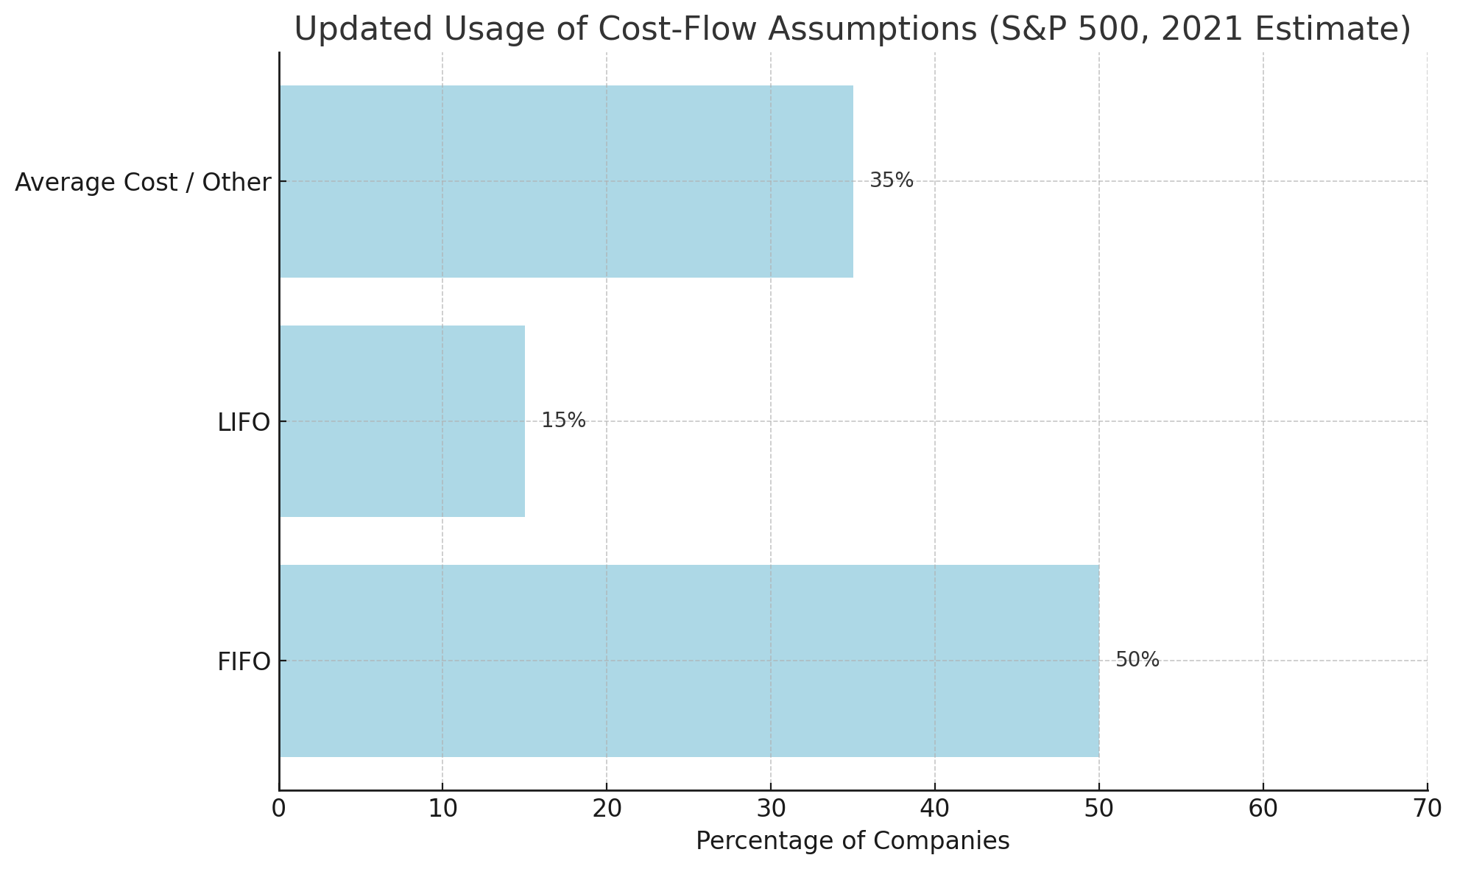
Comparison of methods
Source: TheCorporateCounsel.net, "Companies Using LIFO Face Investor Scrutiny", June 2022
Notes:
Don’t add up to 100 because companies can use different cost assumptions for different inventory items

Slide 24
Handout…

Slide 25

Takeaways
Perpetual and periodic inventory systems determine when to record COGS and update inventory – We will focus on Perpetual most common)
Cost flow methods determine which costs go into COGS and which remain in inventory
Choice of cost flow method can greatly affect net income (if prices are changing over time)

Slide 26
Go to handout…
Bonus Problem

Slide 27
Calculating total COGS and ending inventory
 | Periodic | Perpetual
FIFO
LIFO
Average cost or Moving average
Calculate # of total available for sale over entire period. Allocate to # sold and # left in inventory.
COGS: calculate cost starting from earliest units until total units hits # sold.
Ending Inventory: calculate total cost of available for sale during period and subtract COGS.
Total COGS and ending inventory are the same values as those calculated in periodic FIFO.
COGS: for each sale, calculate cost for units sold starting from earliest units. Add up costs for all sales to get total COGS.
Ending Inventory: calculate total cost of available for sale during period and subtract COGS.
Calculate # of total available for sale over entire period. Allocate to # sold and # left in inventory.
COGS: calculate cost starting from latest units until total units hits # sold.
Ending Inventory: calculate total cost of available for sale during period and subtract COGS.
COGS: for each sale, calculate cost for units sold starting from last units purchase. Add up costs for all sales to get total COGS.
Ending Inventory: calculate total cost of available for sale during period and subtract COGS.
Calculate # of total available for sale over entire period. Allocate to # sold and # left in inventory.
Calculate weighted-average unit cost for total available for sale over entire period.
COGS: compute # sold × weighted-average unit cost.
Ending Inventory: compute # left in inventory × weighted-average unit cost (or calculate total cost of available for sale during period and subtract COGS.)
For each sale, calculate weighted-average unit cost based on available for sale as of that date. Use this unit cost for units that are left over after sale (carry over for next calculation of cost).
COGS: for each sale, compute # sold × weighted-average unit cost. Add up costs for all sales to get total COGS.
Ending Inventory: calculate total cost of available for sale during period and subtract COGS.
Notes:
Just a slide to pause and review.

